Slide 1
Software Engineering
Chapter 7: Software Design -
Unified Modelling Language
State Diagrams
Learning Outcomes
Be able to model the dynamic nature of a system
Be able to draw state diagrams
Text:
Priestley Ch 10
Bruegge Ch 2, Ch 5

Slide 2
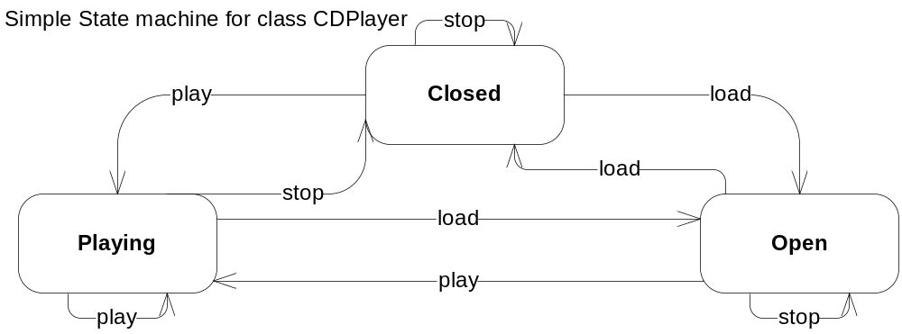
State-dependent behaviour
Where objects respond differently depending on their condition
Example: CD player with [Load], [Play] and [Stop] buttons
  If CD has its drawer closed, then [Load] opens the drawer
  If the drawer is open, then [Load] closes the drawer.
    States are “Open” and “Closed”
    Event causing the transition is “load”
CDPlayer
States
Events
Self-transition
Transition
N.B.: Not all states events and transitions are highlighted

Slide 3
Execution of state machines
Behaviour of a class can be represented in terms of a finite number of states = state machine
UML uses statecharts to model this
Execution
  The current state is called the active state
  When a transition to another state occurs,
  the transition is said to fire
  Events that cause a transition to fire are called triggers
  After a transition the new state becomes the active state

Slide 4
Events, States and Activities
State Diagrams
  ...chart the life-span of an object
  ...in some cases from creation to destruction
  along with the discrete (finite) states in-between
  Where processes operate continuously,
  state diagrams show the state transitions that occur in a cycle.
Event:
  Something that happens at a point in time
    An event has no duration: received messages, time-outs, and error exceptions, for example
State:
  An abstraction of the attribute values and links of an object
Activity:
  An operation that takes time to perform,
  while a particular state of the object is active
  …closely associated with a state
Action
  an operation performed before/after a state change

Slide 5
State Diagram - Notation
name of
event which
causes transition
an action that is
performed when
the event occurs
a pre-condition before
a transition occurs
State 1
do/activity 1
event [guard] /action
State 2
. . .
Finish State
Starting point

Slide 6


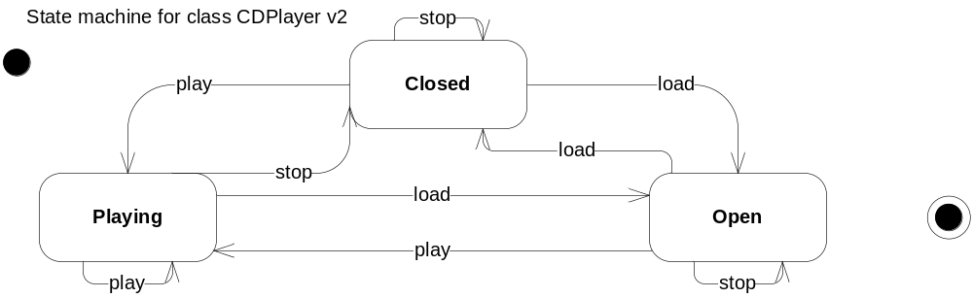
Initial and Final States
Initial state: Model the creation of the objects
Final state: Model the destruction of objects
Exercise 1: Add in the transitions from and to the initial and final states
(transitions are named for the final state only)
Exercise 2: What would the statechart look like for a class Invoice?

Slide 7
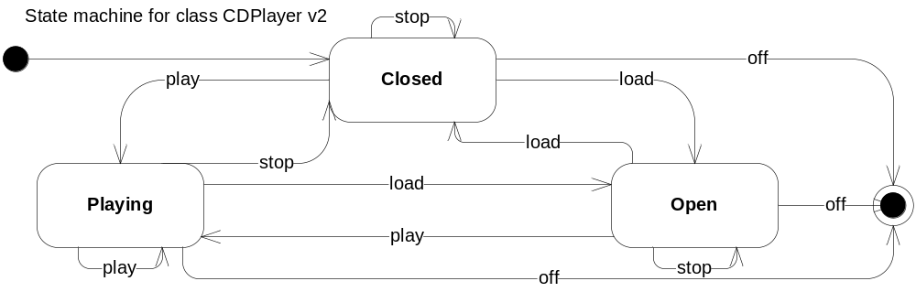
Initial and Final States
Initial state
Final state
Unpaid
pay
Paid
Invoice destroyed

Slide 8
Another example – chess game
Another example – chess game
checkmate
white’s turn
stalemate
black moves
white moves
stalemate
Black’s turn
checkmate

Slide 9
Another example – chess game
Black Wins
checkmate
start
white’s turn
stalemate
Draw
black moves
white moves
stalemate
Black’s turn
checkmate
White Wins

Slide 10
Relationship between Statecharts and the Class Diagram
A statechart relates to ONE class within a class diagram
  The received events are often messages that will have originated at one of the other classes with which the class in question has a relationship
Events are basically received messages and are therefore handled by a receiving class operation
Actions - happening upon a state transition - are usually class operations that may result in a message being sent to another object
Activities - happening within a particular class state - are usually class operations
Statecharts are NOT flow diagrams
- the rounded rectangles are states NOT tasks

Slide 11
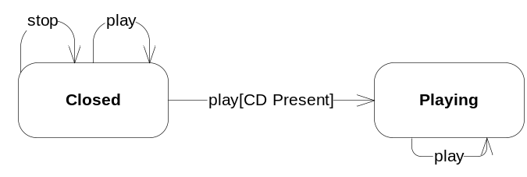
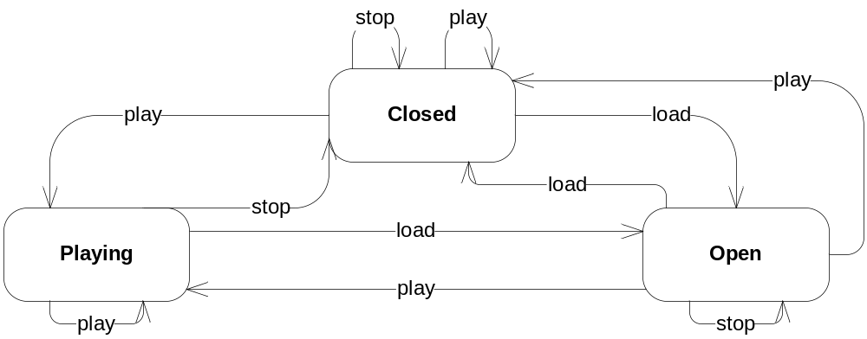
Guard Conditions
Our statechart does not tell us everything yet
  When we press [Play] - does the CD player always play a CD?
  Need guard conditions – shown inside [] after the event
Add this and any other guards you might need

Slide 12
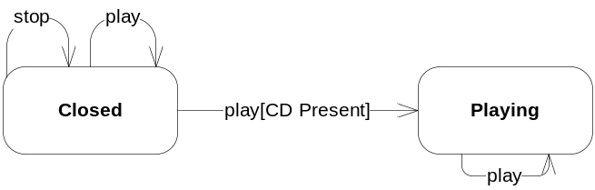
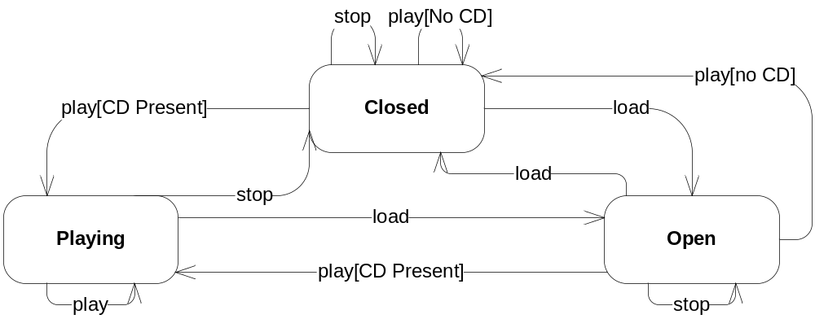
Guard Conditions
Our statechart does not tell us everything yet
  When we press [Play] - does the CD player always play a CD?
  Need guard conditions – shown inside [] after the event
Add this and any other guards you might need

Slide 13
CD Statechart for editing

Slide 14
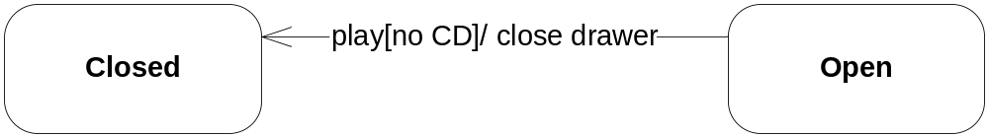
Actions
Objects respond to events and often do something on detection
Actions are short and self contained
(long processes are represented another way - later)
Actions can occur at the point of the transition
E.g.
Any others? Add them to the diagram

Slide 15
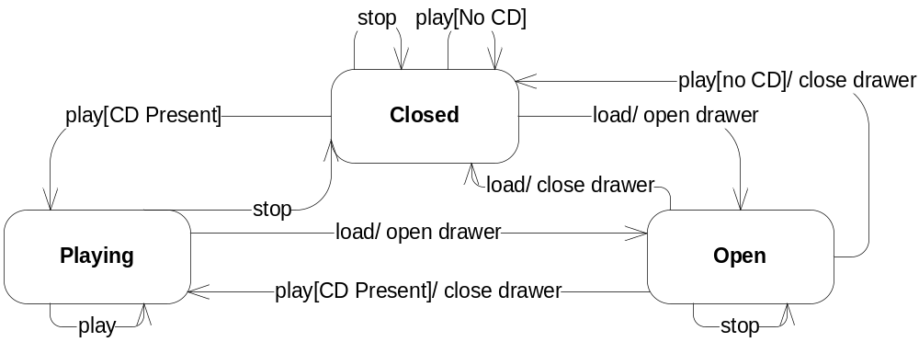
Actions
Objects respond to events and often do something on detection
Actions are short and self contained
(long processes are represented another way - later)
Actions can occur at the point of the transition

Slide 16
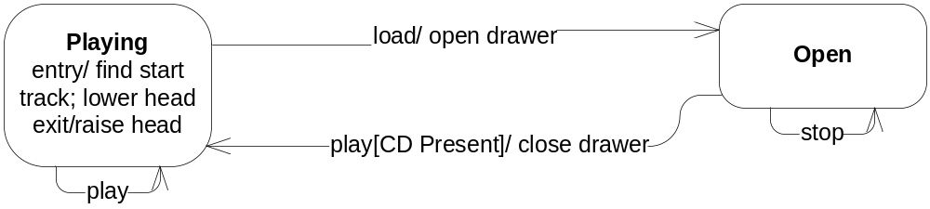
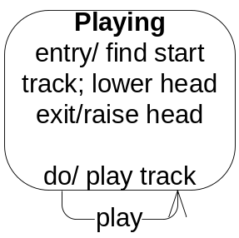
Entry/Exit Actions and Activities
When playing, a CD Player object has to find the first track and lower the head
When finished playing, the head must be raised
Activities: e.g. do / play track

Slide 17
Another example – Alarm system
Alarm System
Monitor
do/ check
detectors
Detected
do/ ring bell
flash lights
access code typed in
Intruder alert/
phone police
Passive
[30 seconds passed]
correct access code typed in

Slide 18
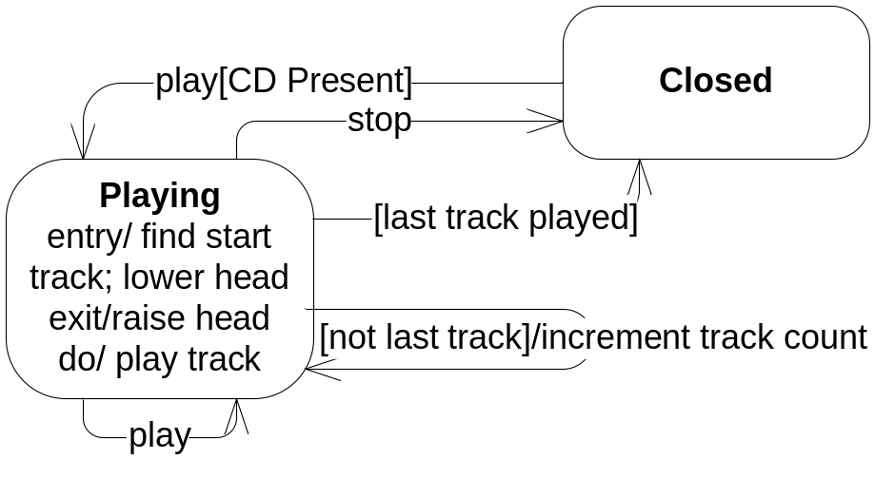
Completion transitions
Activities come to an end and that may cause a transition
  Called completion transitions (with no event label)
  No external event stimulus required (there is an internal one)

Slide 19
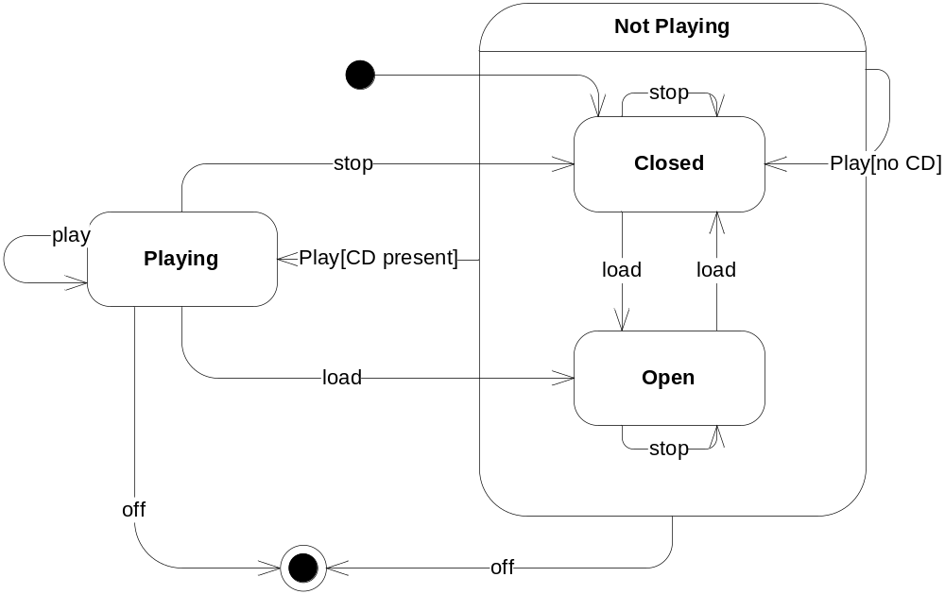
Composite States
Our statechart contains a lot of redundancy
This can be reduced by using superstates
  With CD Player, Closed and Open both have transitions to and from Playing, so...
  Group together states that share the same transitions
From either substate

Slide 20
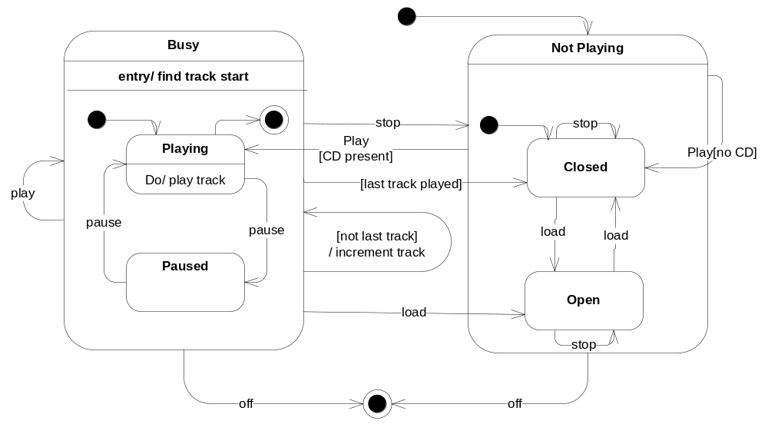
Composite States
Composite states can have actions/ activities of their own
Example
  Suppose that a Paused state is possible
  This transition is fired from Playing but has the same behaviour as Playing
Play
[CD present]
[last track played]

Slide 21
Another Example - Digital Watch
A simple digital watch has a display and two buttons to set it, the A
button and the B button.
The watch has two modes of operation,display time and set time.
In the display time mode, hours and minutes are displayed.
The set time mode has two sub modes: set hours and set minutes.
The A button is used to select modes. Each time it is pressed, it
advances through the modes: display, set hours, set minutes, display
...etc. Within the sub modes, pressing B will advance the hours or
minutes each time it is pressed. Buttons must be released before they
generate another event.
Create a state diagram for the watch.

Slide 22
Possible solution - State Diagram
Pressed B / increment hours
displaying time
Pressed A
setting hours
Do/ flash hours
Pressed A
Pressed A
setting minutes
Do / flash minutes
Pressed B / increment minutes

Slide 23
Summary
All systems have static and dynamic characteristics
The static structure can be described using class models
Behaviour concerns the manner in which the elements within the structure interact over time
State diagrams describe the behaviour of and the internal states within classes, focusing on objects’ actions and state-transitions in response to events
State diagrams can be constructed from problem descriptions or by analysing sequence diagrams

Slide 24
Software Engineering
Chapter 7: Software Design -
Unified Modelling Language
State Diagrams
Learning Outcomes
Be able to model the dynamic nature of a system
Be able to draw state diagrams
Text:
Priestley Ch 10
Bruegge Ch 2, Ch 5

